Slide 1
APPLICATION API DESIGN AND IMPLEMENTATION WITH SPRING FRAMEWORK
Tahir Turgut
27035

Slide 2


ABOUT THE COMPANY
Commencis Teknoloji A.Ş.
Digital Transformation, Big Data and its analysis
Engineering Department
Lead: Oytun Kurtar
Mentor: Aslı Gönülşen

Slide 3



About the Project
An application:
Closed-community
Second-hand belongings sales
Serves in 3 platforms: Web, iOS and Android

Slide 4
Motivation and status at the beginning
Pandemic!!!
Relocations from Istanbul
Trust issues
Kick-off
Priorities has been set (database, mock servers)
Requirements has been stated (for all project)
Tasks are distributed

Slide 5
Methodology
MySQL
draw.io
Java
Spring Framework
JPA
Hibernate
Swagger
Gerrit
Jenkins

Slide 6


Learnıng about the technologıes
The documents (swagger.io, spring.io etc.)
Onboarding Project
3 basic endpoint design (login -> return information -> get account info)
Gained insight about Spring Framework and API design

Slide 7
Project detaıls
Designing the database
Item Entity
User Entity
Photo Entity
UserActivityLog

Slide 8


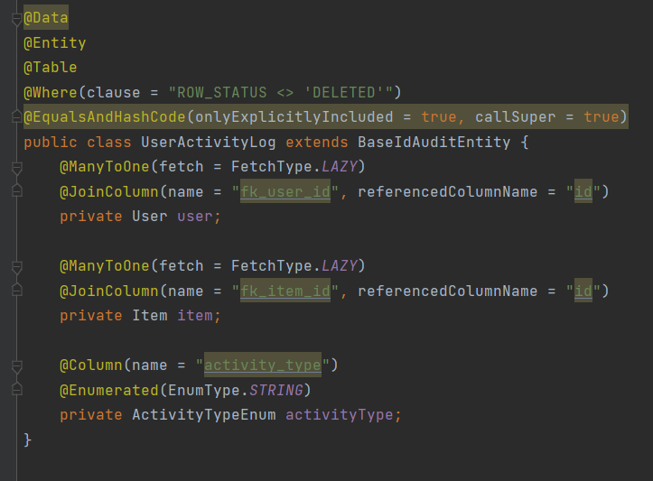
Project detaıls
JPA Annotations
Many to One Relationships

Slide 9
Project detaıls
Swagger open API configurations
Endpoint designs

Slide 10
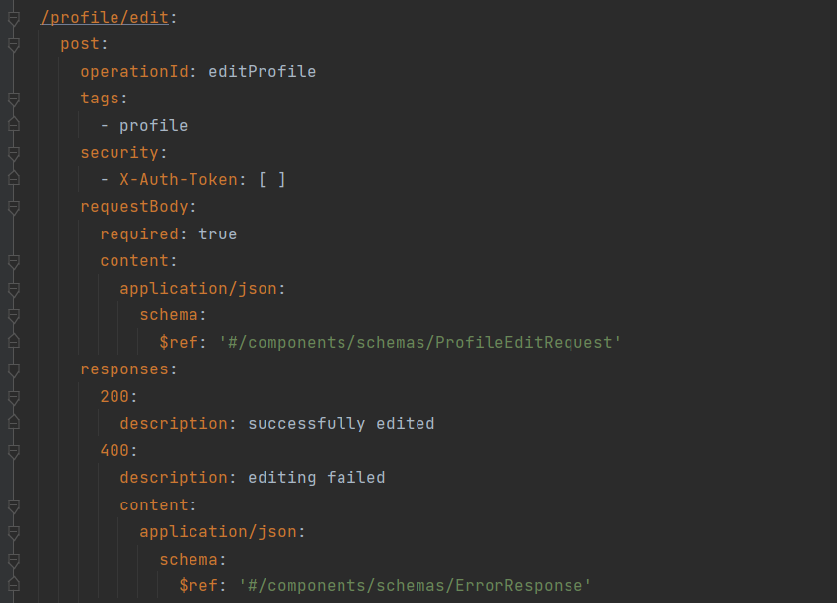
Project detaıls
Paths (/profile/edit)
Methods (post, get, delete)
requestBody (if schema is needed)
Application/json (data type)

Slide 11
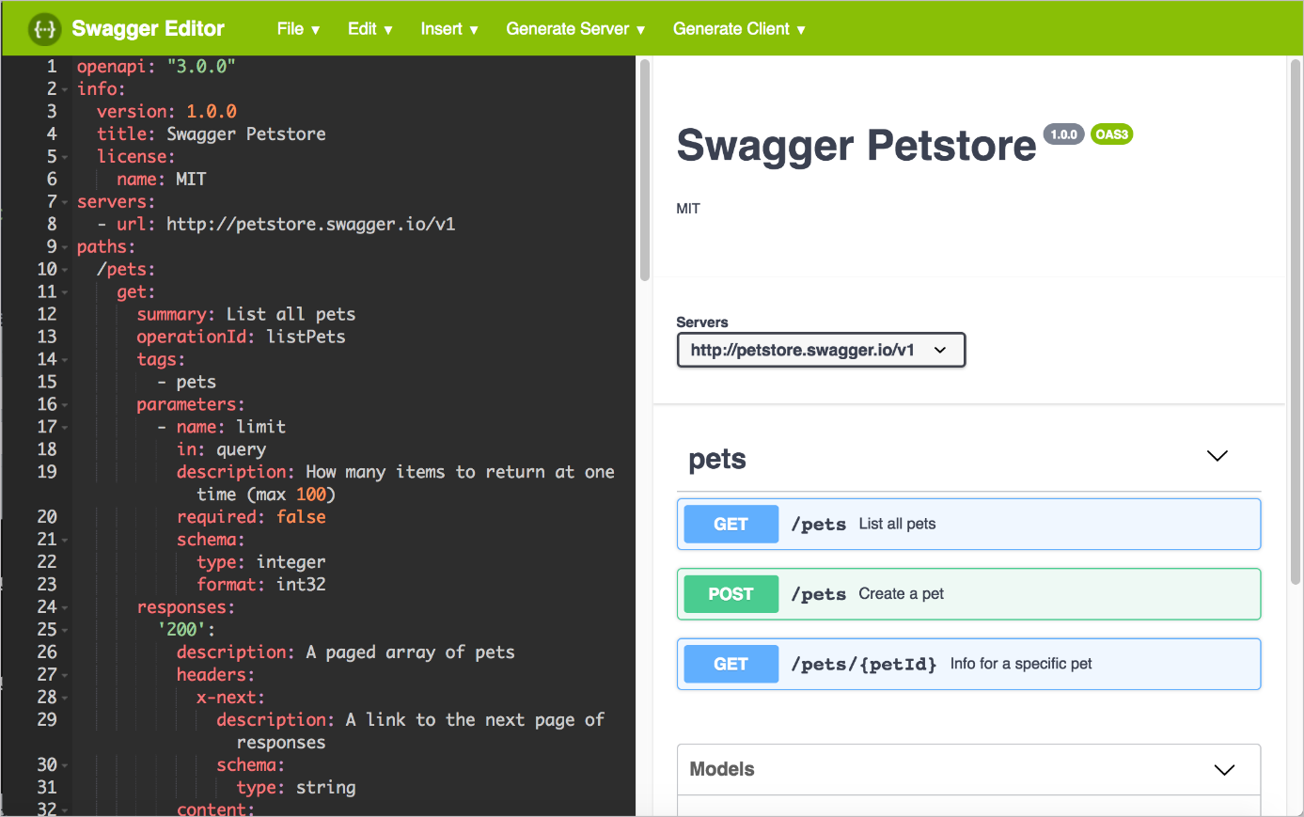
Project detaıls
Tags
Parameters
Responses (schema may be needed)
Required: true, false

Slide 12
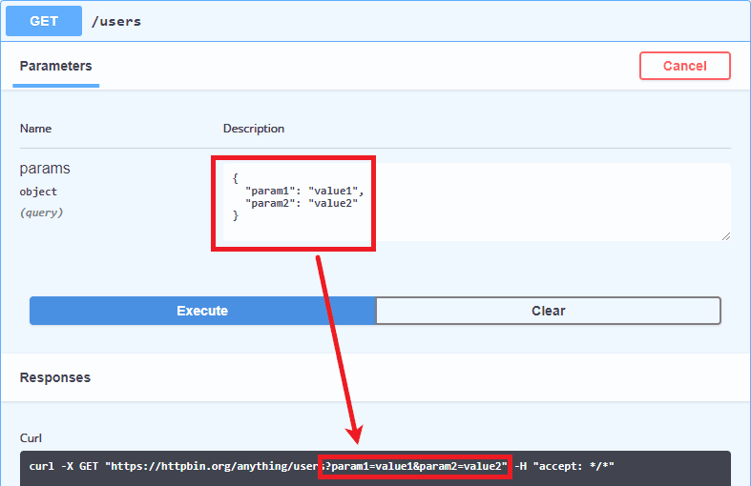
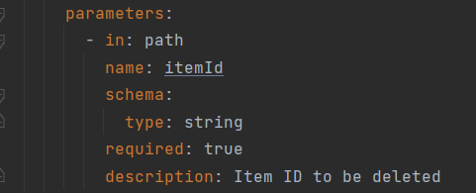
Project detaıls
Path variables
Query variables

Slide 13
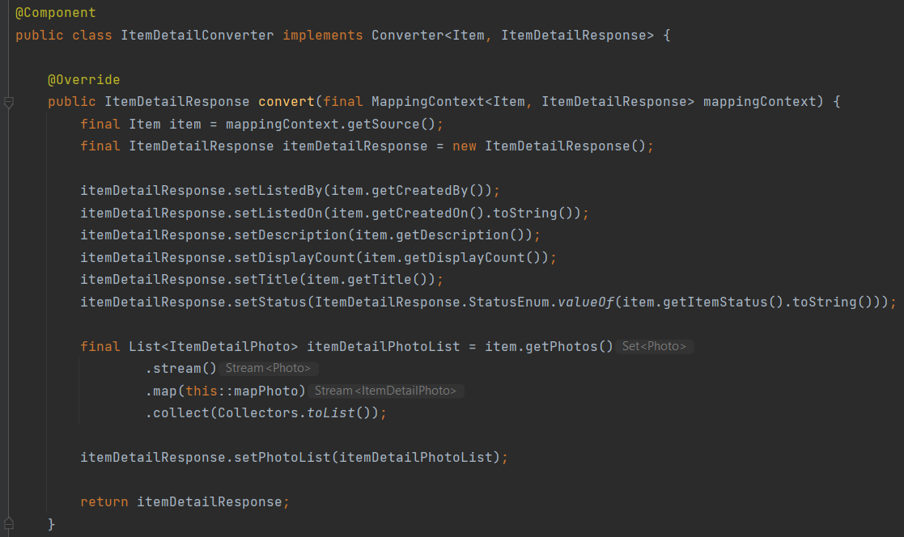
Project detaıls
Converters

Slide 14
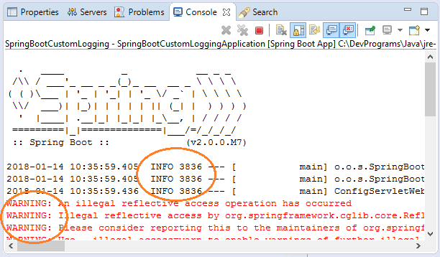
Result of the Project
Not implemented yet:(
Additional features, logger
Still ongoing process

Slide 15
What have ı learned?
Design and implementation of REST API services and database connection
Spring Framework, JPA and Hibernate and Gerrit, Swagger Codegen
Agile methodology and scrum framework
University background importance

Slide 16
Thanks for lıstenıng!

